Slide 1
Java SE 17 – Presentation
Chapter 11 – Exceptions and Localizations

Slide 2
Chapter 11 – Exceptions and Localization
Understanding Exceptions
- A program can ... for any ...
+) ... lost ...
+) ... index ...
+) ... divide ...
– These are outside ...
– How can we solve these ? ...
The role of Exception
- Exception in Java means ... "... done ..."
Return code VS Exceptions
(code illustration snippet 1)
- Most of the ... algo uses ... indicating ... If our code has ... then we should ... instead of ... values... Java also has an entire ... for this...

Slide 3
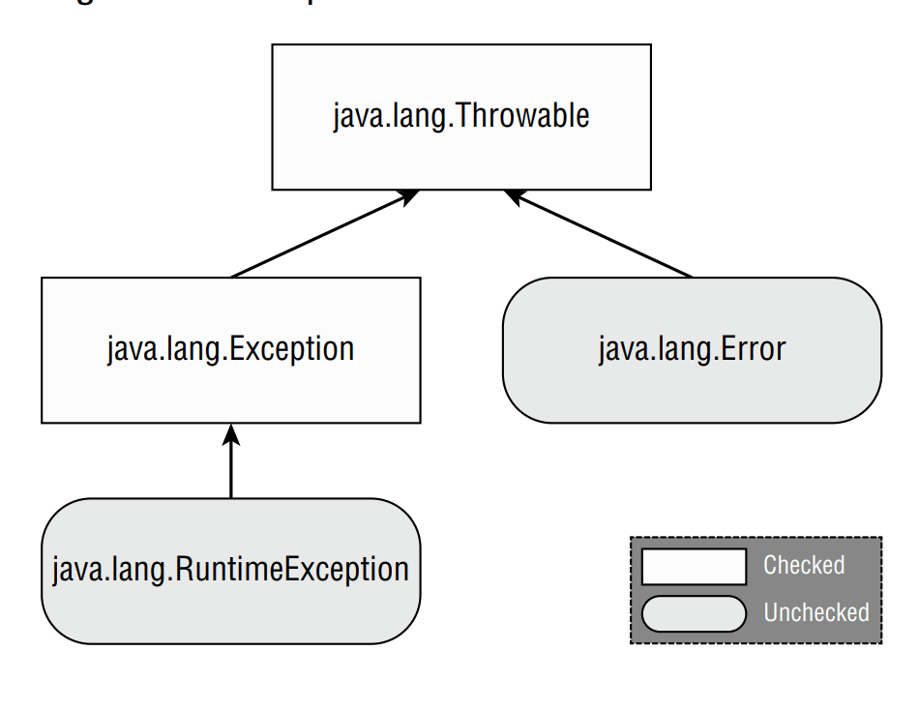
Chapter 11 – Exceptions and Localization
Understanding Exception types

Slide 4
Chapter 11 – Exceptions and Localization
- The correct meaning of different exceptions:
+) ...
+) ...
+) ...
Checked Exception
- In Java, Checked Exception is ...
(code illustration 2,3)
Unchecked Exception
- In Java, Unchecked Exception is ...
(code illustration snippet 4)
Error and Throwable
- This is ...

Slide 5
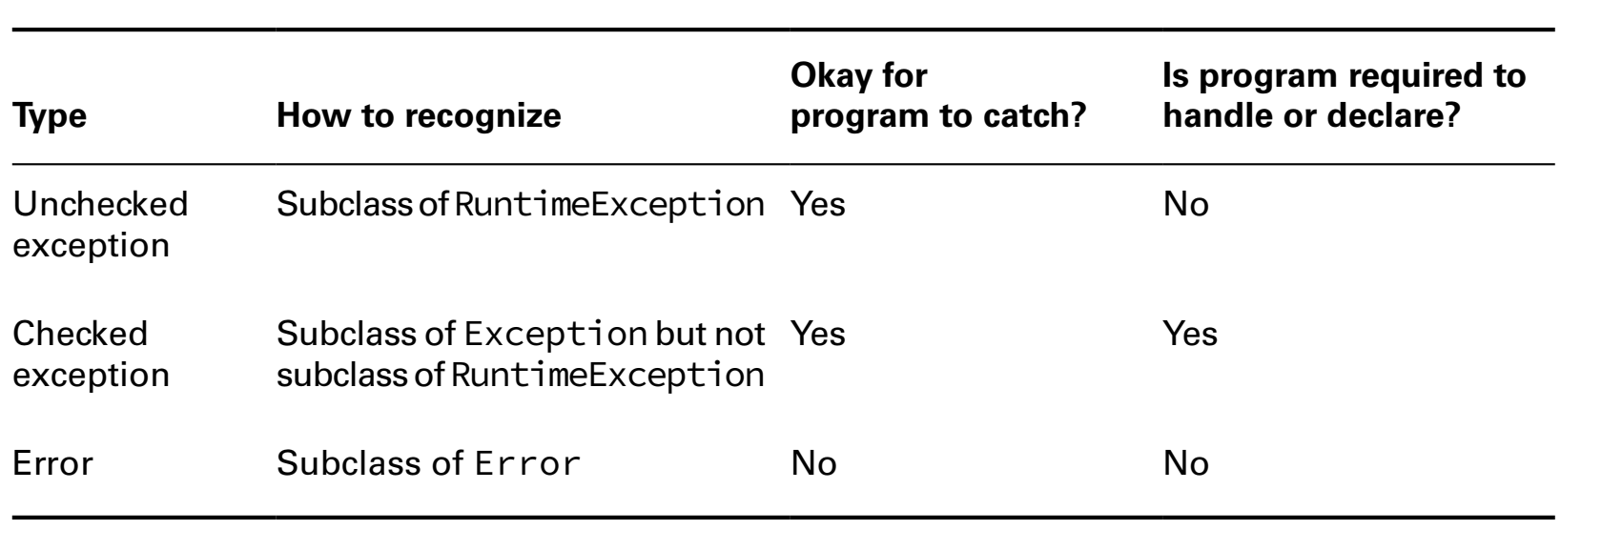
Chapter 11 – Exceptions and Localization

Slide 6
Chapter 11 – Exceptions and Localization
Throwing an Exception
(code illustration snippet 5, 6)
- The difference between ... and ... is ...
- When we create our own ... we usually pass ... or ... Convention is ...
(code illustration snipept 7, 8, 9)
Calling methods that throw Exceptions
(code illustration snippet 10, 11, 12, 13)
- Every time we use ... we must check ... compatible ...
Overriding methods with Exceptions
(code illustration snippet 14, 15)
Printing an Exception
(code illustration snippet 16)

Slide 7
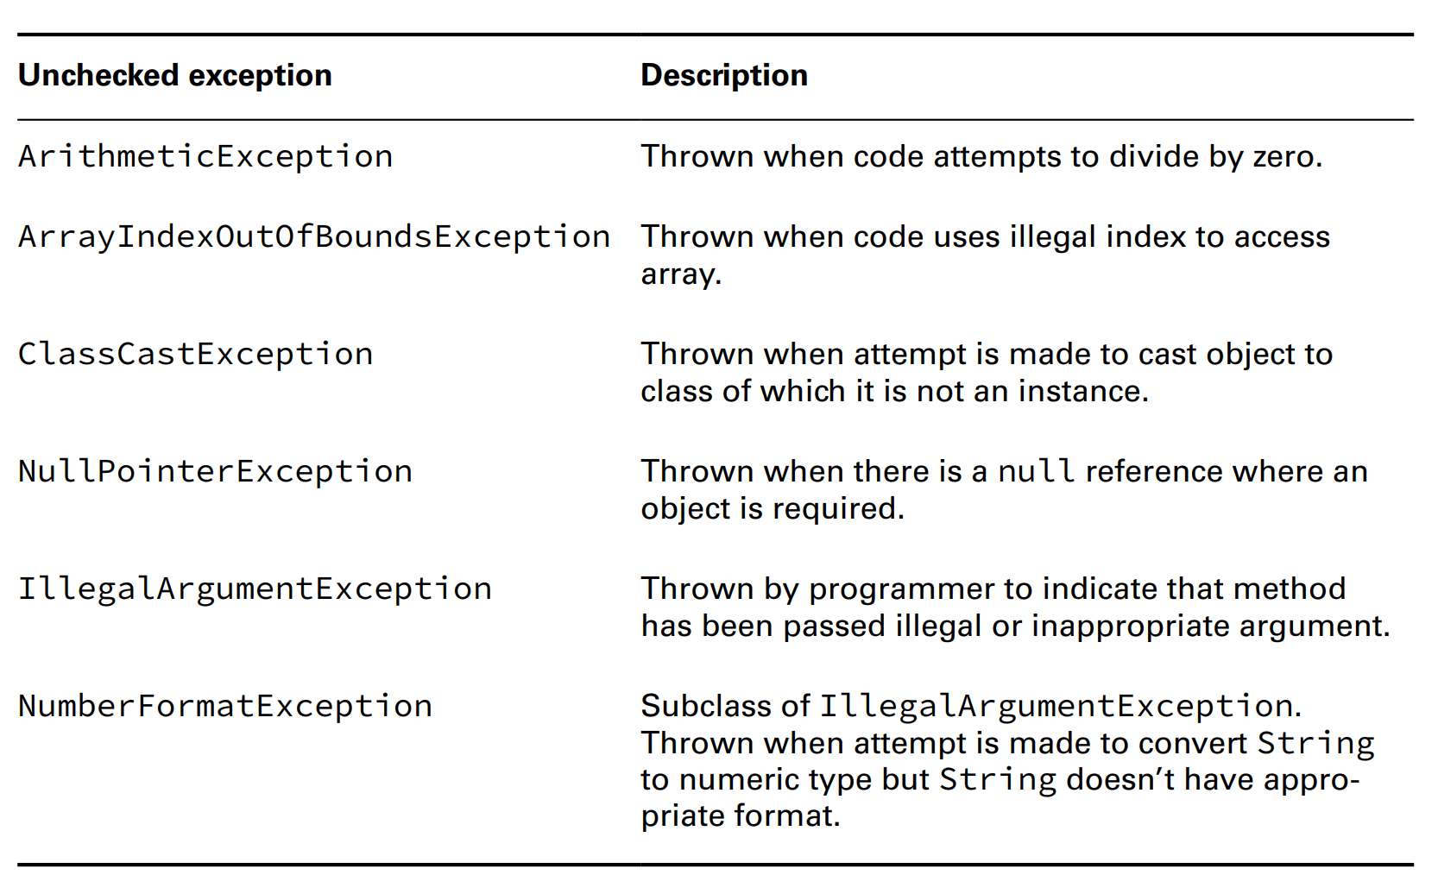
Chapter 11 – Exceptions and Localization
Recognizing Exception Classes
RuntimeException classes

Slide 8
Chapter 11 – Exceptions and Localization
ArithmeticException
ArrayIndexOutOfBoundException
ClassCastException
NullPointerException
-Note: In the new version, ... more information ... because it prints ... This is called ... NPE
(code illustration snippet 17)
- By default, when we compile ... it will shows .... If we want to ... we have to compile using ... flag ...
(code illustration snippet 18)
Enabling/Disabling helpful NPE
- When ... introduced in Java 14, it was a ... so we have to use

Slide 9
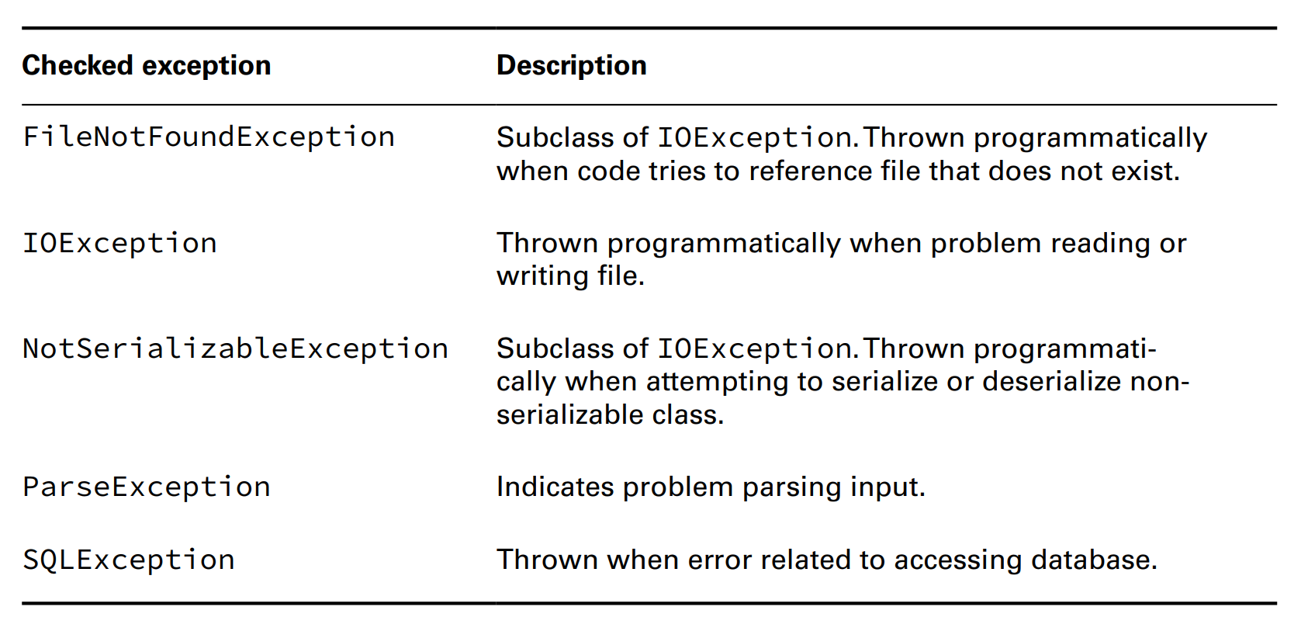
Chapter 11 – Exceptions and Localization
- However, in Java 15 onward, it has been ... => Running with it will ...
IllegalArgumentException
NumberFormatException
(code illustration snippet 19)
CheckedException classes

Slide 10
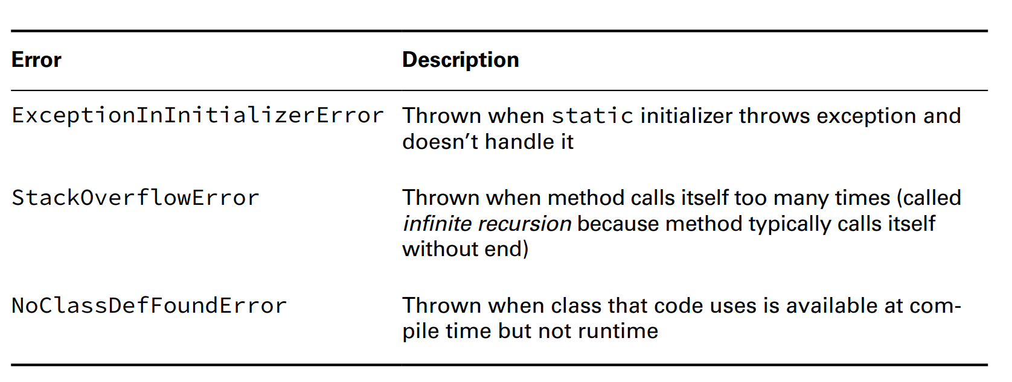
Chapter 11 – Exceptions and Localization
ErrorClasses

Slide 11
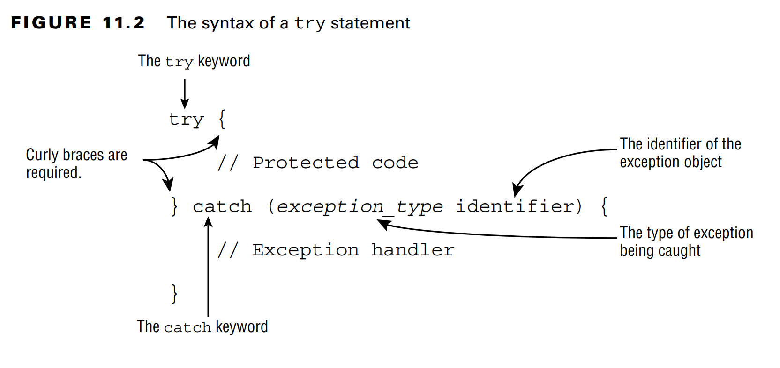
Chapter 11 – Exceptions and Localization
Handling Exceptions
Using try-catch statements

Slide 12
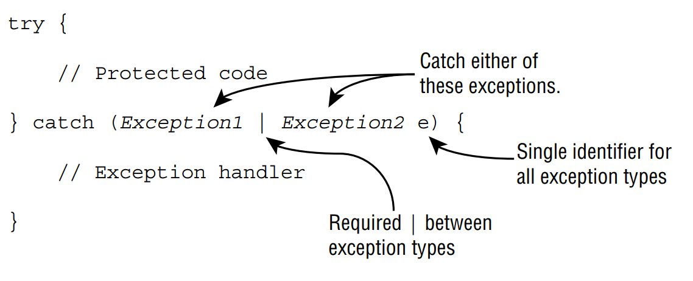
Chapter 11 – Exceptions and Localization
(code illustration snippet 20,21,22)
Chaining Catch block
- This means
(code illustration snippet 23, 24,25,26,27)
Applying a Multi-catch block
- In most cases, we want ... same for multiuple ... no matter ...
(code illustration snippet 28)
– We can handle this using ...
(code illustration snippet 29)

Slide 13
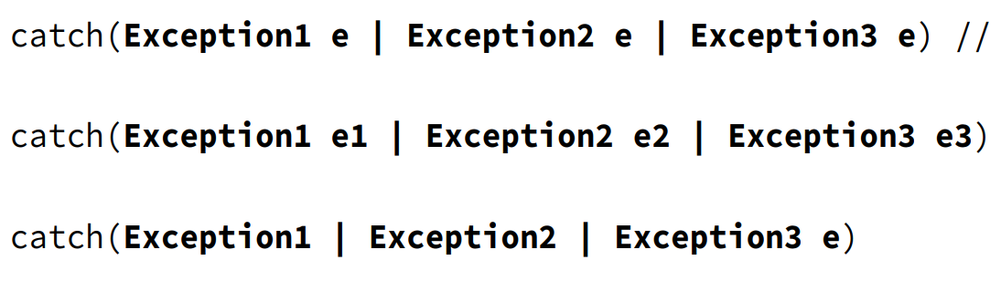
Chapter 11 – Exceptions and Localization

Slide 14
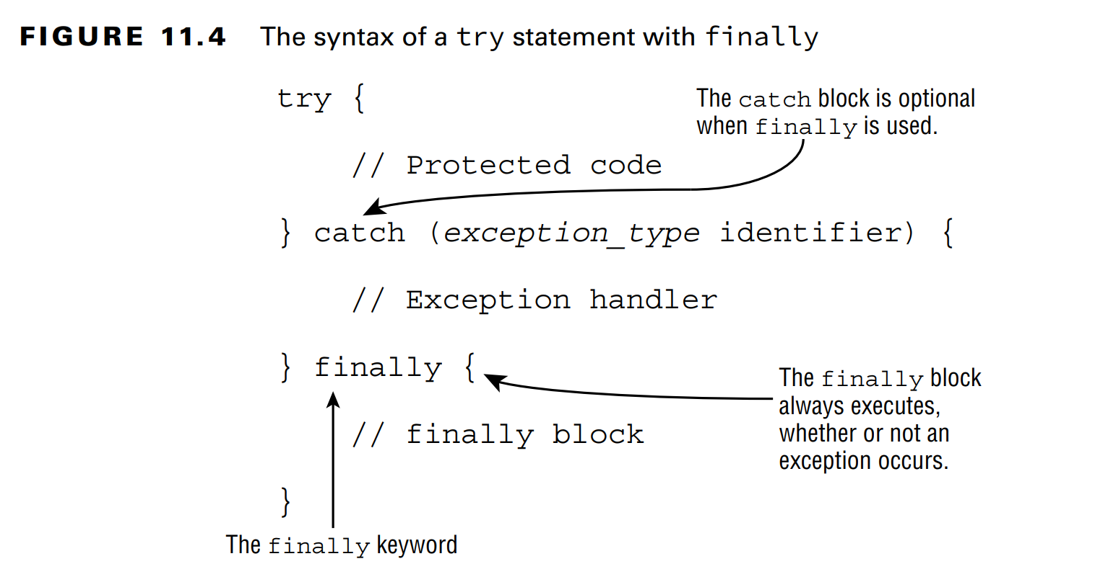
Chapter 11 – Exceptions and Localization
(code illustration snippet 30,31)
Adding a finally block
- Finally clauses ... always ...
- try ... finally ..., catch ... finally ...

Slide 15
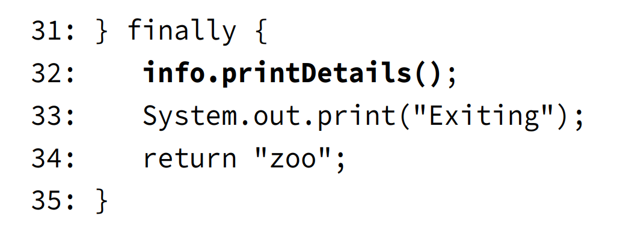
Chapter 11 – Exceptions and Localization
(code illustration snippet 32,33,34,35,36)
- What happen if 32 throws NPE ?

Slide 16
Chapter 11 – Exceptions and Localization
System.exit()
- There is only 1 ... where finally ..., which is ...
(code illustration snippet 37)
Automating Resource Management
- Most of the time, our app works with ..., ... and others ... => We call this as ...
– In many cases, we open ... with them (no matter ... or ...) and we .../... on it. Then we ... to indicate ...
– If we don't ... the resources ... => Many things will ...
– If it is database, then no ... can ... until ...
- These problems are called resources ...(similar to ... ) => Making the resource ...
Introducing try-with-resource
(code illustration snippet 38)
- This is a long ... (because there are ... IOE ... handle)
- Half of ... just ... More resources = ... (for example, if we have many ... and we have to ... in order .... What if one of them throw ...).
- Java solved this using .... to close ... in try ... (it has other name which is ... because Java does this ...)
(code illustration snippet 39)

Slide 17
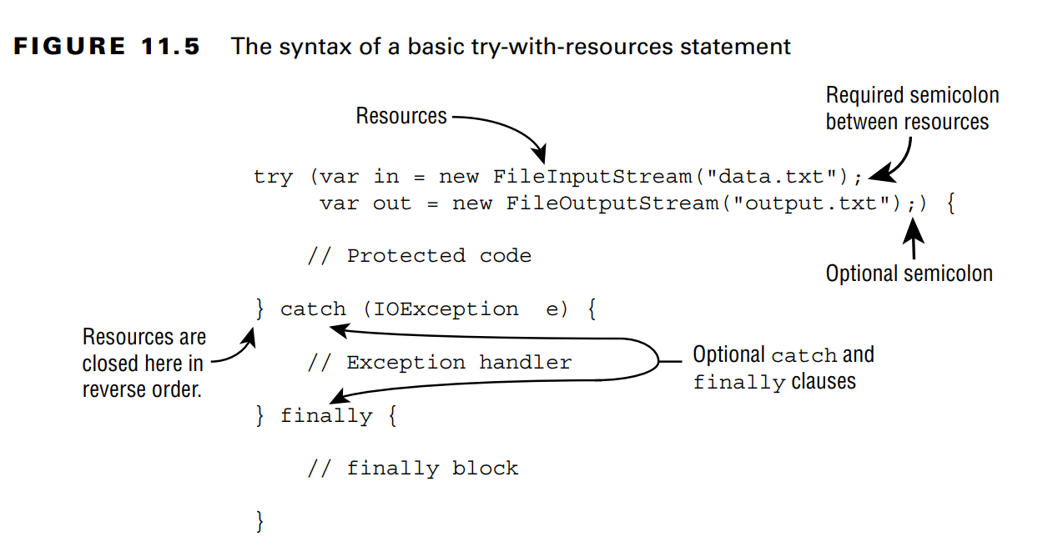
Chapter 11 – Exceptions and Localization
- Technically, these 2 codes are ... However, the important parts is not ... but Java will automatically ... when the resource out ...
- Behind try-with-resource is a ... clauses => This is called .... because compiler ... we still can create ... however, we must rememeber that ... before our ...

Slide 18

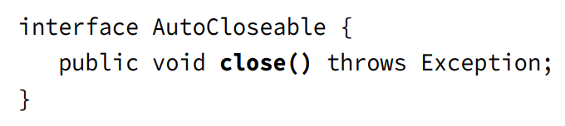
Chapter 11 – Exceptions and Localization
(code illustration snippet 40)
Constructing Try-with-resource statements
- Only classes that implements ... can be classified ...

Slide 19
Chapter 11 – Exceptions and Localization
- Of course ... override ...
(code illustration snippet 41)
- In chapter 14, we will see some ... implements ... instead of ... Since ... is a child of ..., both of them support ...
– The difference is that ... throws ... and ... throws ...
Declaring Resources
(code illustration snippet 42)
- Because resource is just like ..., we can use local variable ...
(code illustration snippet 43)
Scope of Try-with-resource
- Opened resource has scope ... This is a way to remember that ... first then ... (because after it ..., how can we use ...)
(code illustration snippet 44)
Following Order of operation
- Java will close ... in ... order
(code illustration snippet 45)

Slide 20
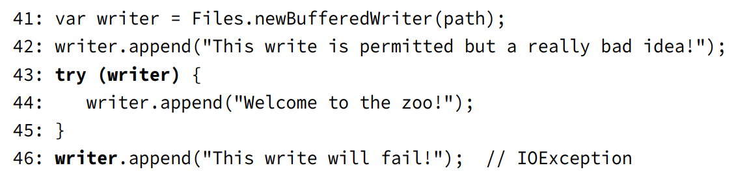
Chapter 11 – Exceptions and Localization
Applying Effectively final
- In most cases, we ... resources in ... However, we can ... beforehand, but it must be ... or ...
(code illustration snippet 46,47)
Understanding Supressed Exceptions
- This is the hardest topic, the question of this topic is "what if close() throws ..."
(code illustration snippet 48,49)
- What if try also ... If there are multiple ... then all ... except ... will be ... and the first one will be ... (The idea is that Java will consider the first .... is ... and all of the other one willl be ... during the ...)
(code illustration snippet 50,51)
- In general, ... exceptions will follow the ... order (just like normal) and the first ... will be ...

Slide 21
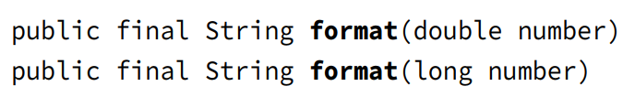
Chapter 11 – Exceptions and Localization
- Please be careful that this only happen if ... in ... and ... only
(code illustration snippet 52)
- Note: This code doesn't run because this is how Java ... If finally ... and try also ... then finally ... and ... ignored
Formatting values
- We come back to old ...
Formatting Numbers
- In chapter 4, we studied about String .... However, it is kinda ... and the mechanism is ... => We need a better solution => Introducing NumberFormat ... (idk why the books said ..., when it is a ... class)

Slide 22

Chapter 11 – Exceptions and Localization
- Since ... is a ... class => we need a ... class to use ...

Slide 23
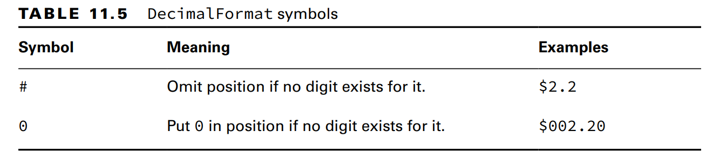
Chapter 11 – Exceptions and Localization

Slide 24
Chapter 11 – Exceptions and Localization
- Note: We just need to specify ... and Java will ... it (no matter ...). Also, if the number is too ... (double only) then it will be ... due to ... Moreover, if we specify ... like 000,00 or 00,000, then Java will ...
(code illustration snippet 53)
- Later on in Localization, there will be another ...
Formatting Dates and Times
(code illustration snippet 54, 55,56)
Customizing the Date/Time Format
- If we don't ..., we can ...
(code illustration snippet 57)
- Every char is ...
- The number of char ...
– In the exam, there will be possibilities that it will ask us an old ... SimpleDateFormat ... just know that ... compatible

Slide 25
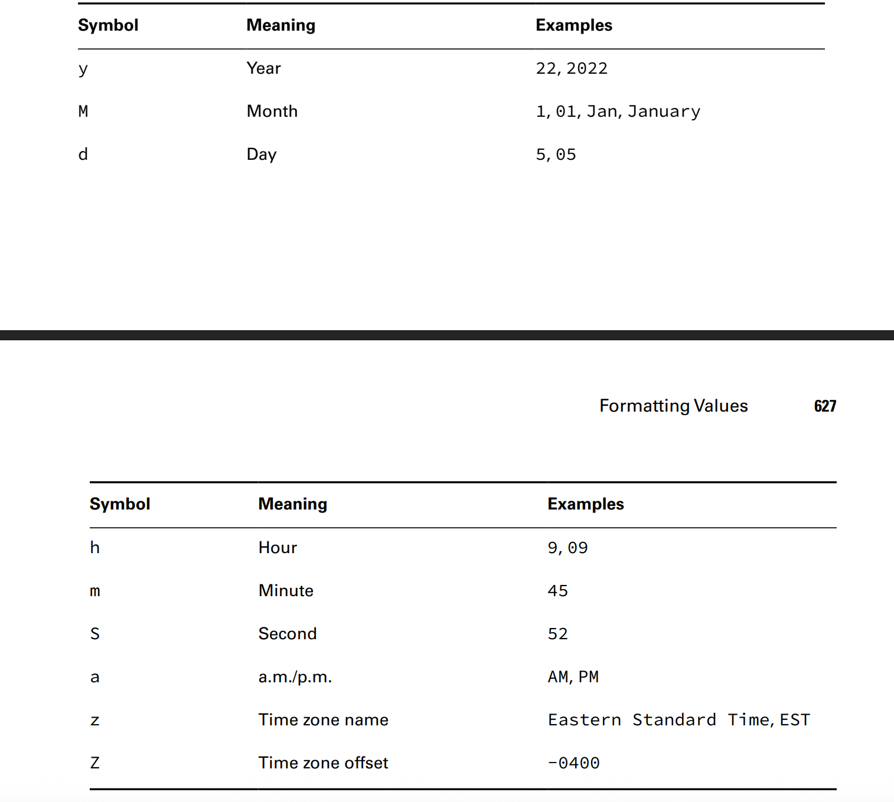
Chapter 11 – Exceptions and Localization

Slide 26
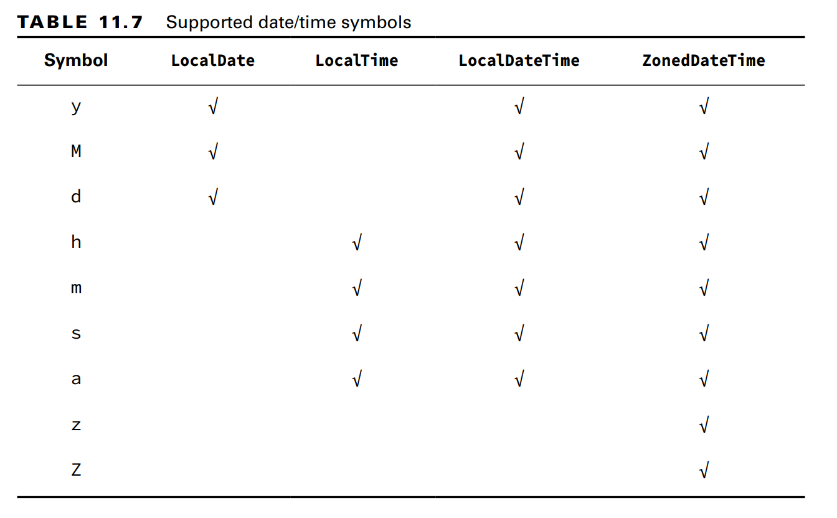
Chapter 11 – Exceptions and Localization
(code illustration snippet 58)

Slide 27
Chapter 11 – Exceptions and Localization
Selecting a format() Method
- DateTime has ... and DateTimeFormatter has ... => ...
(code illustration snippet 59)
Adding Custom Text Values
- However, String format will ... each char is ... => If we ...
- A way to solve this is ... String ...
(code illustration snippet 60)
- However, if the code is getting more ... => ... long => Java allows us to ... additional ... using single ...
(code illustration snuppet 61)
- But what if we still want to use single ... in our ... too ? Then we can use ... just like how we use ...
(code illustration snippet 62,63,64)
- If we don't use ... then ...
(code illustration snippet 65,66)

Slide 28
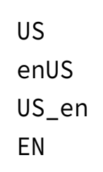
Chapter 11 – Exceptions and Localization
Supporting Internationalization and Localization
- Many apps have to ... in different ... with ... different (for example, an ... in 1-4 in ... will be interpreted as ... in British) If we ... app in different ... we must use ... format
– Internationalization (...) is a process that ... This process puts ... into a file called ... and ensure that we use ...
- Localization (...) means ... many different ... and .... region ... We can understand ... as ... pair of ... and ...
- Localization includes ..., converting ... into ...
– Note: In the first stage of ... we dont need, .... We will need ... later on ...
Picking a Locale
- In the exam, we only need ... The real ... of Locale is ... but we ...
– The class ... resides in ... package ... The first ... we must ... is the ... user ...
(code illustration snippet 67)
- When we run the ..., it will ... out "en_US" (could be ..., depends on ...) This means the ... is English and the ... is US
- Notice the format is that ... and ... (the ... is optional)

Slide 29
Chapter 11 – Exceptions and Localization
- In the exam, we only need ... We dont need to ... all ... and ...
– As a developer, we must pick ... There are ... ways to do this
- The first way is to use ... in ... class for ... popular ...
(code illustration snippet 68)
- The second way to do this is to ... pass in a ....
(code illustration snipept 69)
- Java allows ... new ... by just pass in ... However, there will be ... match ... and the program will run ...
- The third way to ... that is more ... is using ... builder ... We can ... any ... order
(code illustration snippet 70)
- Although we ... the order, but Java will ...
– When testing ..., we might want to use ... rather than default ...
(code illustration snippet 71)
- Note: the exam changes the ... because it can't assume ... However, in real ... we rarely ...

Slide 30
Chapter 11 – Exceptions and Localization
Localizing Number
- Formatting, parsing ..., or ... can be changed depending on which ... (for example, $2.15 .... 2,15 pound)
- Fortunately, the package ... included some ... that save times when ...
- The first thing before ... is to have an instance of ...
– When we have the ... we can format ... or convert ... to ....

Slide 31
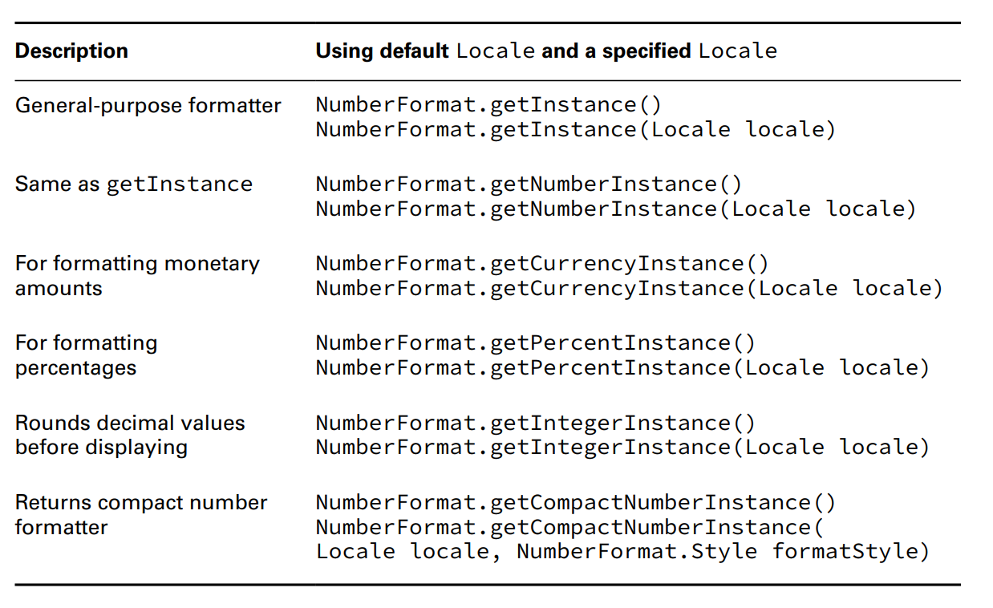
Chapter 11 – Exceptions and Localization

Slide 32
Chapter 11 – Exceptions and Localization
Formatting Numbers
- When we format ... usually from ... to .... => we have method ... () to ... depend on the ... we use that is linked to the ... instance
(code illustration snippet 72)
- ... currency ...
(code illustration snippet 73)
- In the real world, money will be ... in ... or ... because if we use double, then ... due to ... => Lost ... will result in ...
- ... percentage ...
(code illustration snippet 74)
Parsing Numbers
- When we ... data, we convert from ... to ... and ... => The method ...() will be used to ... and it is related to ...
- parse() appears in ... forms ... and it throws ... that must be ...
(code illustration snippet 75, 76)
- Note: the return type is ... => a ... operation must be ...

Slide 33
Chapter 11 – Exceptions and Localization
Formatting with CompactNumberFormat
- The 2nd class that ... NumberFormat is CompactNumberFormat. This guy is the same as ... Format but used in cases where ... printing ... limited
- ... customizable with different ... and different ...
(code illustration snippet 77)
- If we don't ... style, short ... used ... The value after .... will be ... Moreover, the postfix for ... such as K, M ...
(code illustration snippet 78)
- Notice that ... round ... for the ... that use ... Format ...
– Some rules for the CompactNumberFormat:
+) It will determine the ... (B,M,K) ?
+) .... round up to ...
+) If short then ... If long then ...
Localizing Dates

Slide 34
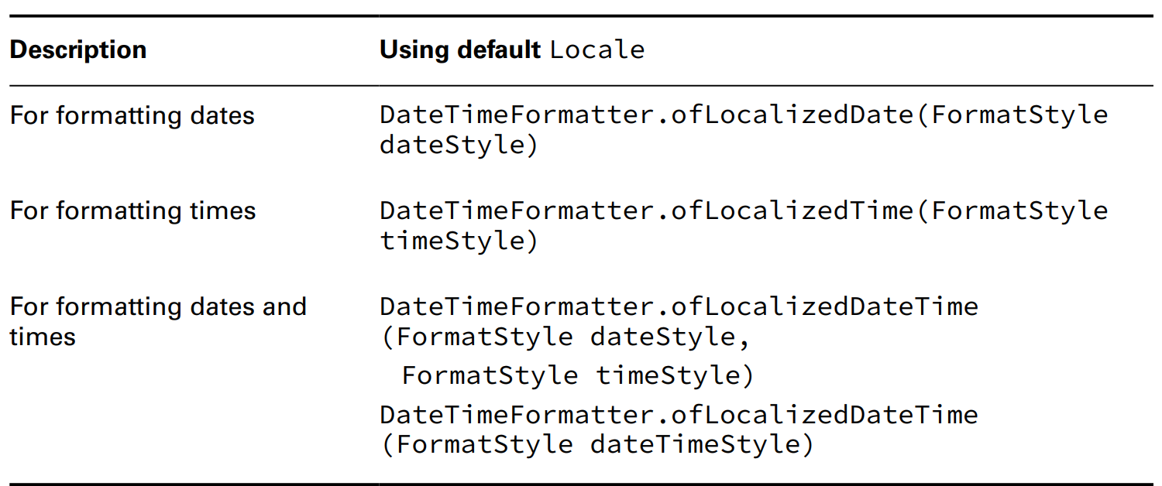
Chapter 11 – Exceptions and Localization

Slide 35
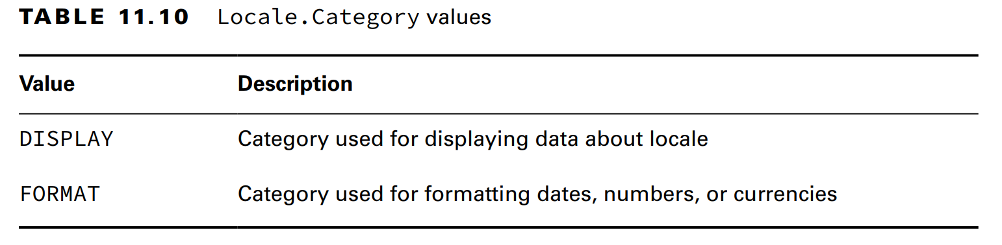
Chapter 11 – Exceptions and Localization
- Each method requires ... (..., ..., ..., ...) ...
- If we need a particular ...er and ... we can just use with...(...) and append it to the ...
(code illustration snippet 79)
Specifying a Locale Category
- When we call ...() with a locale, some ... has been chosen inside ... not us
- If we want finer-grained ... Java separated with .... inside ... enum
- This is a nested type in ... class that divides ...

Slide 36
Chapter 11 – Exceptions and Localization
(code illustration snippet 80)
Loading Properties with Resource Bundles
- Up until now, we ... all text ... for user inside .... However, Localization requires us to ... it ...
– Resource bundle contains ...-specific ... for us to use the ...
– It is a form of ... pair ... Resource bundle are stored in ... file
- ... file is a special ... file that has format of ...
- Our last program is ... now we need ... USA, Paris, Canada ...
(code illustration snippet 81)
- In the next part, we will create ... It is literally a ... with each line ... pair ... separared with ... or ...
Creating a Resource Bundle
- Now we will update ... to support the ... Lucklily that Java doesn't require us to ... If we don't have the ... then Java will use the ...
- We will now create ... US and France
(code illustration snippet 82)
- Notice that the file name must ... followed by ... and then ended with ...
(code illustration snippet 83)

Slide 37
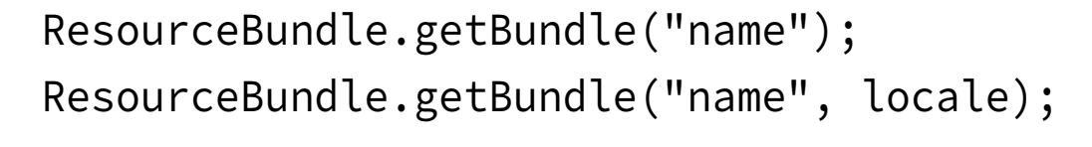
Chapter 11 – Exceptions and Localization
- Because Resource Bundle is a bunch of ... we can loop through ...
(code illustration snippet 84)
Loading Resource Bundle files at runtime
- In the exam, just assume that ... we don't need to know where ...
– In real life, resource bundle could be ... We can put them in .. file but it is not recommended ... because if we change ...=> we have to re... the whole ...
- An advantage of using ... is the separation between ... and ...
- We should separate ... into a separate JAR and load it using .... when ... because we can change ... without ...
Picking a Resource Bundle
- There are ... ways of getting ... First, we specify ... only, second, we specify ... and required ...

Slide 38
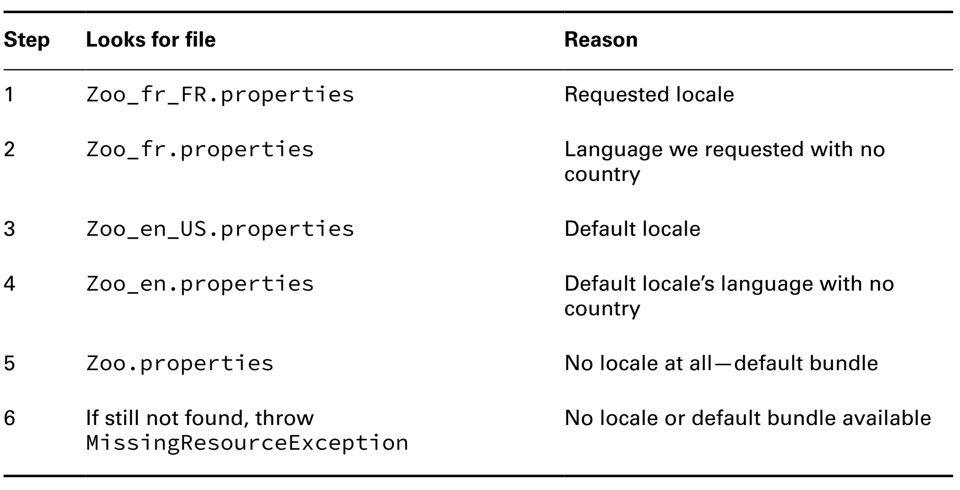
Chapter 11 – Exceptions and Localization
- The first one ...
– The second one ...
– Java handle the finding .... for a specific ... using ... order ...
– The table here is the order .... with default ... for finding ...

Slide 39
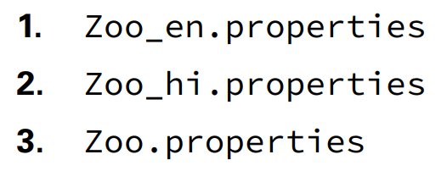
Chapter 11 – Exceptions and Localization
- The order is:
+) Find ... with requested locale, then continues with ...
+) With each ..., ....full ... and ... only ...
+) Use default ... when ....
- Question how many files are related with the finding of the resource bundle in this code ?

Slide 40
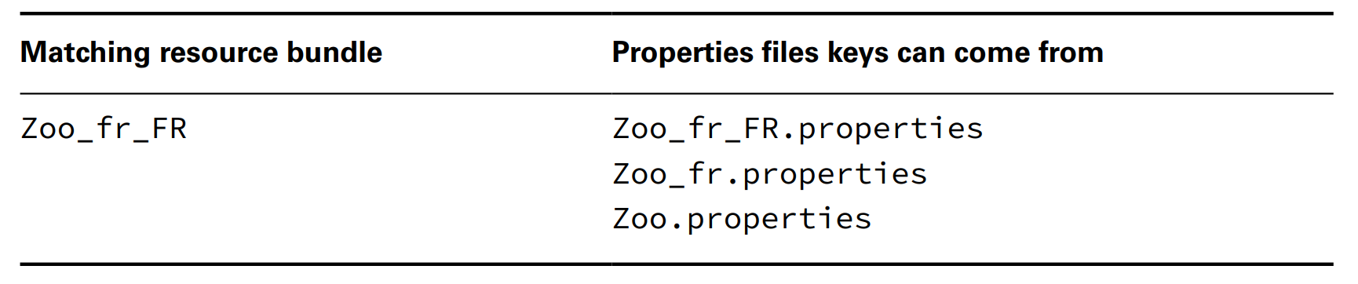
Chapter 11 – Exceptions and Localization
Selecting Resource Bundle values
- A thing to remember is that a key willl ... in a single ...

Slide 41
Chapter 11 – Exceptions and Localization
- Once a ... is chosen, only ... fron that ... is ...
- Default ... will only be chosen if ...
- If both full ... and only ... are found, then ... + .... will be used ...
(code illustration snippet 85)
- If the previous example refers to ... An ... will be thrown ...
Formatting mesdsages
- Normally we just ... however, sometime, we might want to ... variables ... => We have a convention of using ... with ... to indicate the ...
– Although normal ... doesn't support, we have a class called ... to do that
(code illustration snippet 86)
Using the Properties class
- When working with ... we also encounter a class called ... It works just like ...<...>
(code illustration snippet 87)
- The method ...() will return ... and return ... if ...
– Properties class also have another method ...() that won't accept ... and will ...
(code illustration snippet 88)

